Slide 1
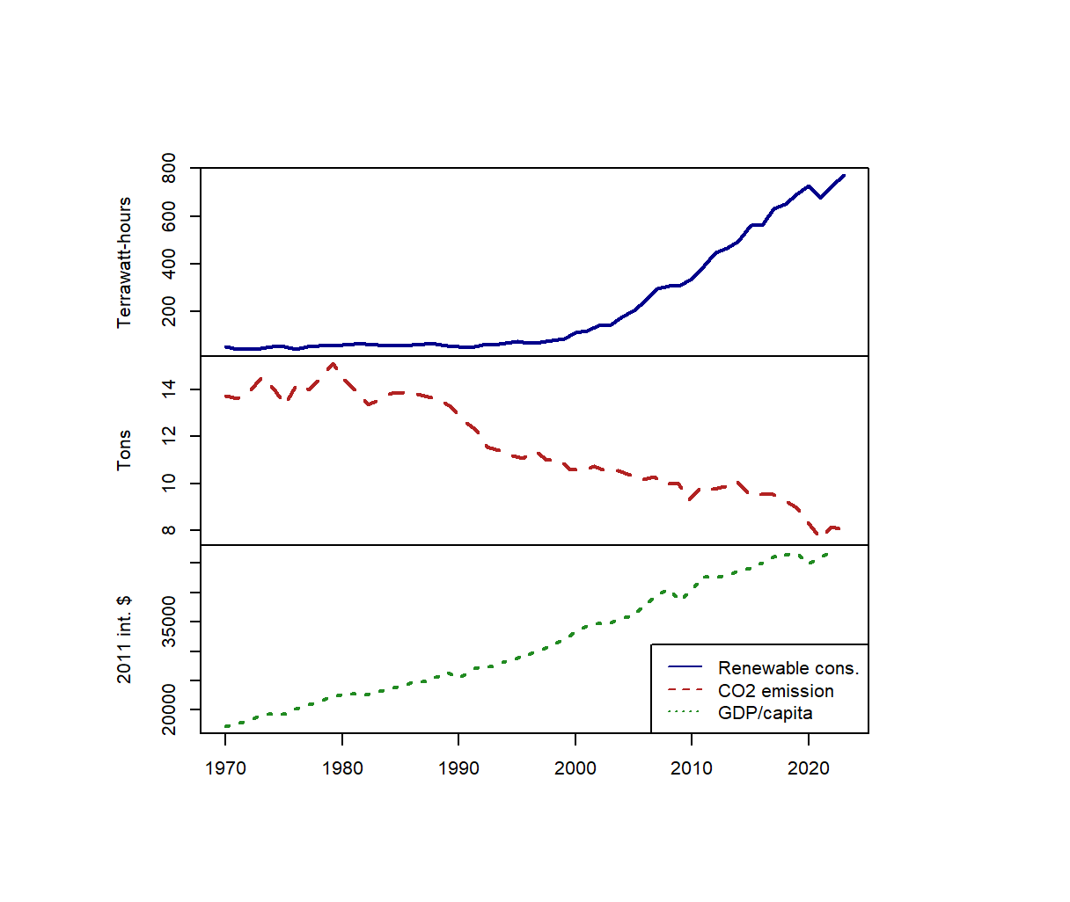
Renewable Energy Consumption in Germany
and its effects on CO2 emissions
Data
Renewable Energy Consumption: Energy Institute - Statistical Review of World Energy
Link: https://www.energyinst.org/statistical-review
Time: 1970 – 2023
Unit: Terawatt-hours
CO2 Emissions per capita: calculated with World Bank Development Indicators
Link: https://databank.worldbank.org
Time: 1970 – 2022
Unit: Tons of CO2 per capita
GDP per capita: calculated with data from our world in data
Link: https://github.com/owid/energy-data
Time: 1970 – 2022
Unit: international $ rate of 2011 power parity adjusted
Fig. 1 Data visualized as time series

Slide 2
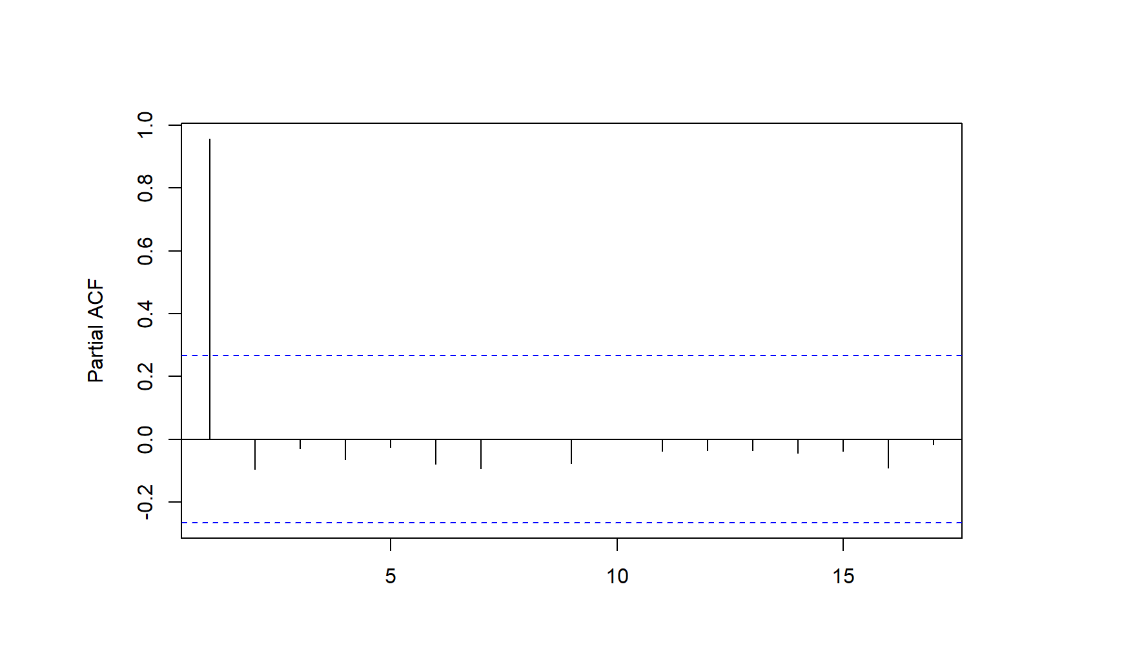
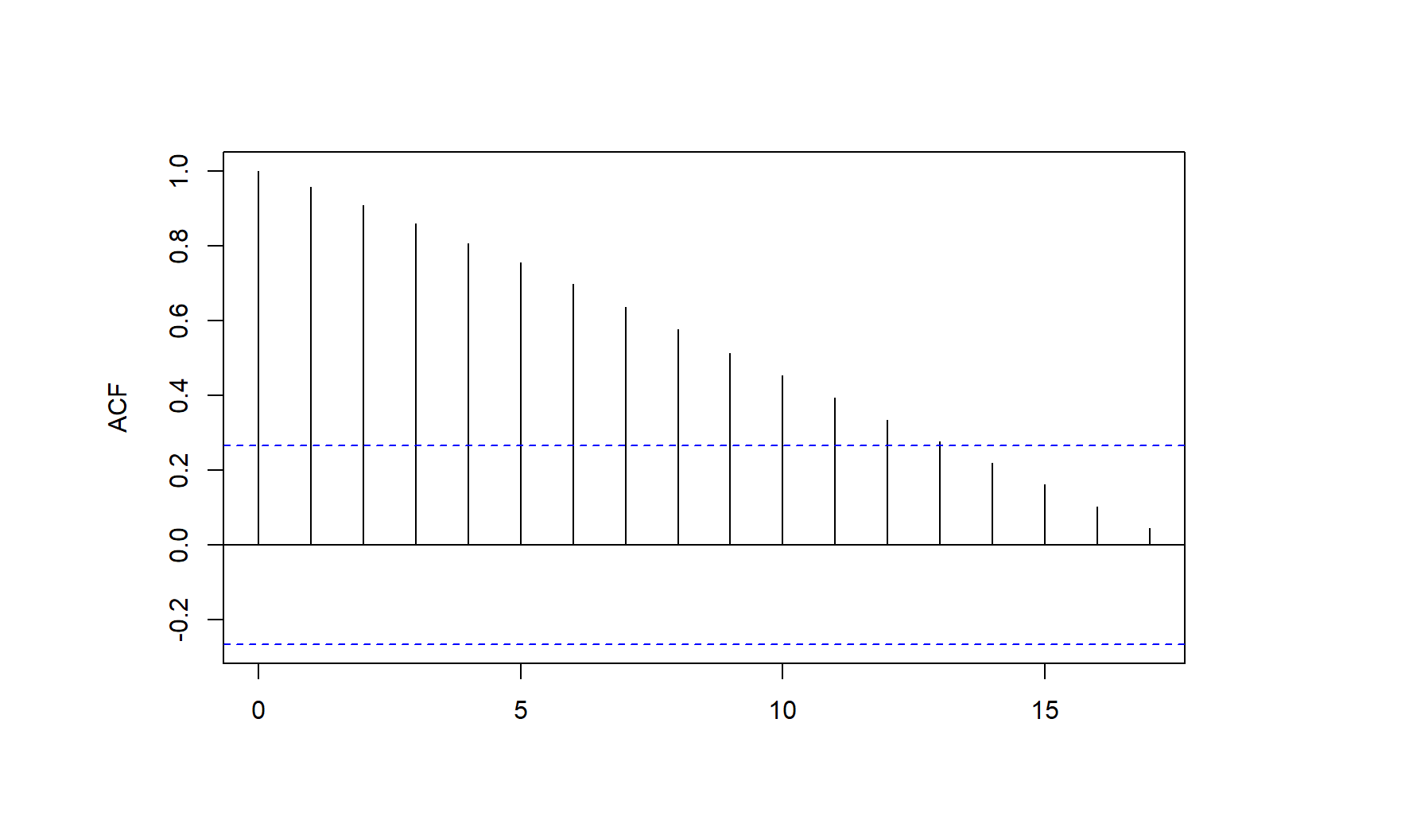
Energy Consumption – Finding a Model
Modelling the renewable energy consumption in Germany:
Fig. 1: show trends in the data
Log transform data
Augmented Dickey-Fuller (ADF) test: -1.8875 (p-value = 0.6448)
does not reject stochastic trend → Work in difference I(1)
Stationarity: First order difference of log(renewable consumption)
ADF: -5.1243 (p-value = 0.0001) → reject H0 of non-stationarity
Corellelograms indicate:
ARIMA(1,1,1)
ARIMA(1,1,0)
ARIMA(2,1,0)
ARIMA(1,1,2)

Slide 3
Energy Consumption – Model Selection
 | Significant Terms | Ljung-Box Test, p-value | AIC | BIC | MAE (h=1) | MAE (h=4)
ARIMA(1,1,1) | All | 0.25 | -93.23917 | -86.76252 | 0.0462 | 0.0870
ARIMA(1,1,0) | All | 0.10 | -88.03597 | -78.41083 | 0.0654 | 0.2033
ARIMA(2,1,0) | AR1 only | 0.13 | -87.44525 | -83.71821 | 0.0628 | 0.1776
ARIMA(1,1,2) | AR1 and MA1 | 0.26 | -91.23932 | -82.60379 | 0.0469 | 0.0890
Check if forecasts are significantly different
Diebold-Mariano test on ARIMA(1,1,1)
 | h=1 | h=4
ARIMA(1,1,0) p-value | 0.878 0.400 | 3.790 0.004
ARIMA(2,1,0) p-value | 1.814 0.093 | 1.229 0.247
ARIMA(1,1,2) p-value | 1.765 0.101 | 1.212 0.254
Model of choice: ARIMA(1,1,1)
Lowest AIC
Lowest BIC
Lowest MAE (h=1 and h=4)
Not significantly different
All terms are significant
Residuals are white noise
Optimal Model

Slide 4
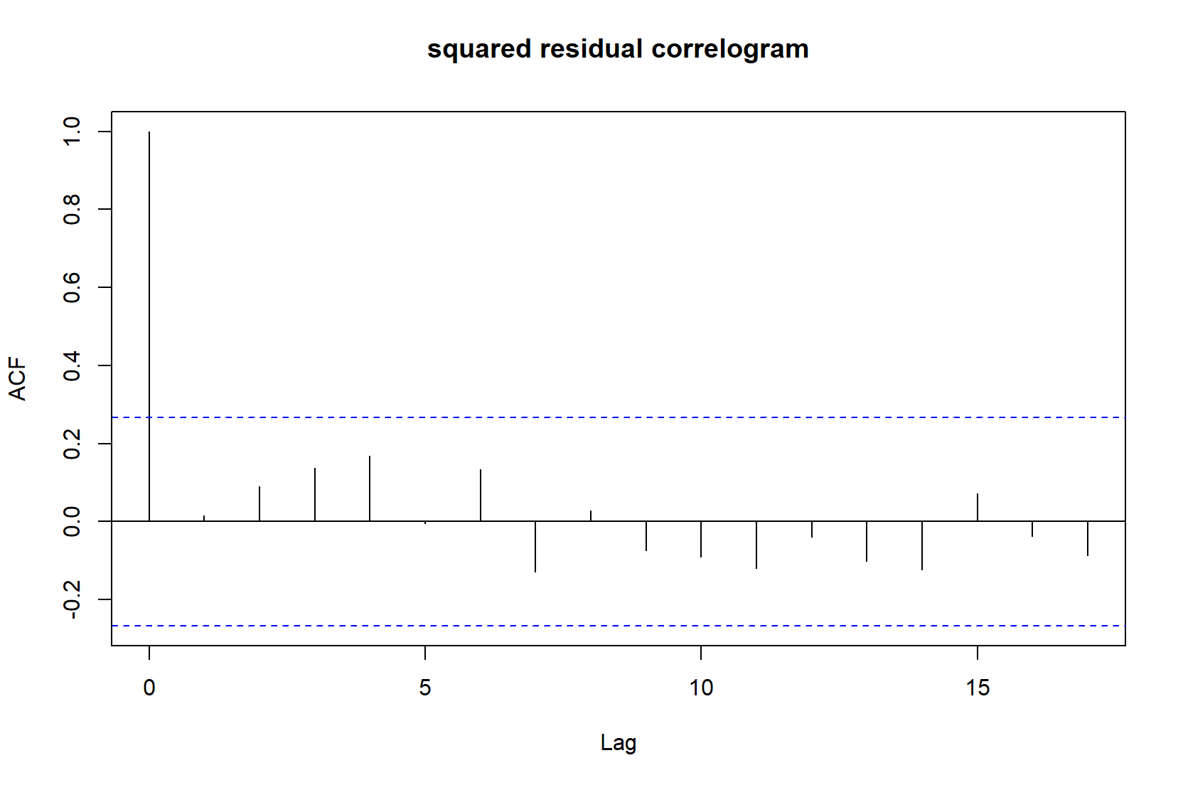
Model Validation
Model ARMA(1,1,1)
Ljung-Box Q-test on residuals:
8.9802
P-value 0.2541 > 0.05 → We do not reject H0 and conclude that residuals are white noise
Indication for valid model
Check squared residuals:
Correlogram
No significant autocorrelation in squared residuals
No heteroscedasticity suspected
Model ARIMA(1,1,1) is valid
Continue with forecasting

Slide 5
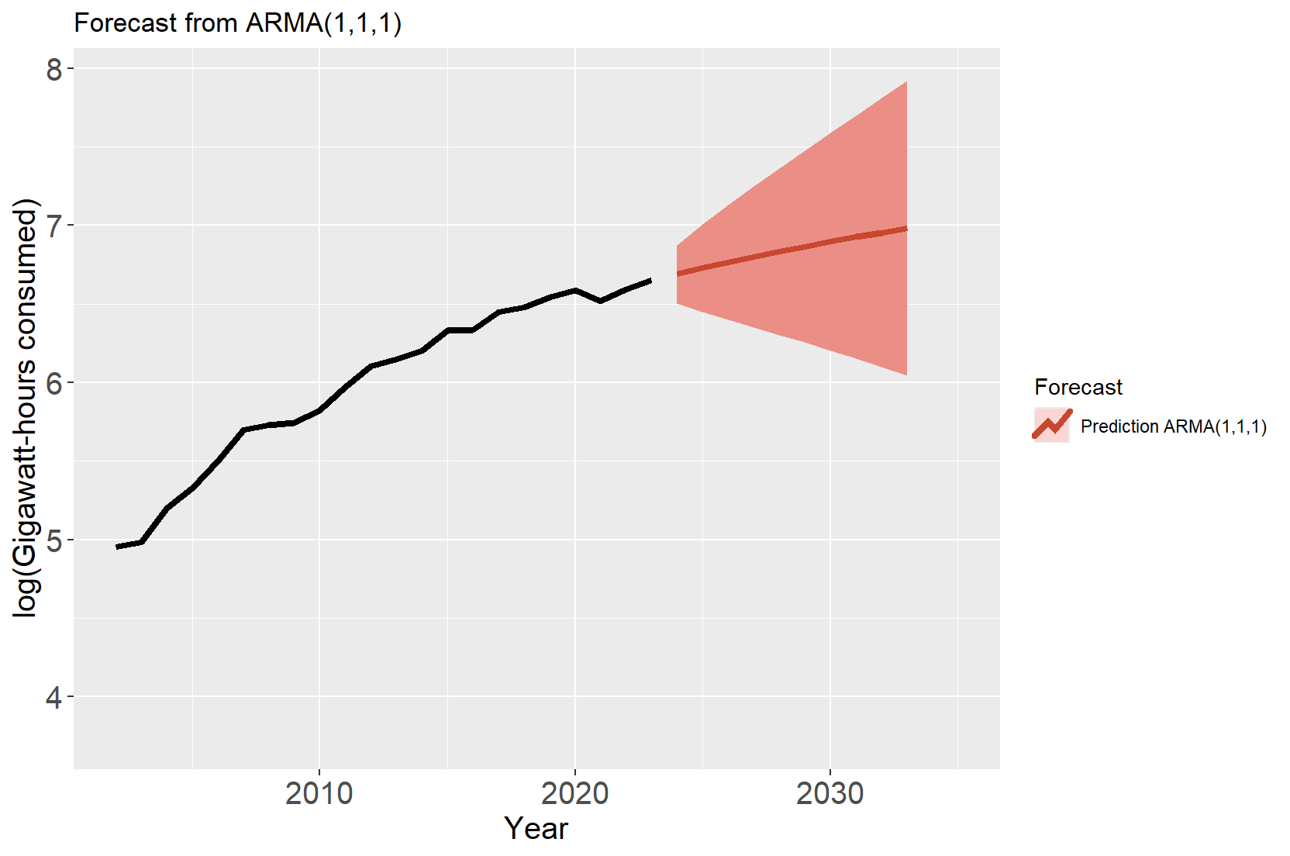
Energy Consumption – Forecast ARIMA(1,1,1)
Year | Forecast | Low 95% | High 95%
2024 | 6.69 | 6.51 | 6.88
2025 | 6.73 | 6.45 | 7.01
2026 | 6.76 | 6.40 | 7.13
2027 | 6.80 | 6.35 | 7.25
2028 | 6.83 | 6.30 | 7.36
2029 | 6.87 | 6.25 | 7.48
2030 | 6.90 | 6.20 | 7.59
2031 | 6.93 | 6.15 | 7.70
2032 | 6.95 | 6.10 | 7.81
2033 | 6.98 | 6.04 | 7.92
*Plot produced with ggplots Autoplot function for nicer visualization
→ Renewable energy consumption in Germany is forecasted to increase in the next 10 years

Slide 6
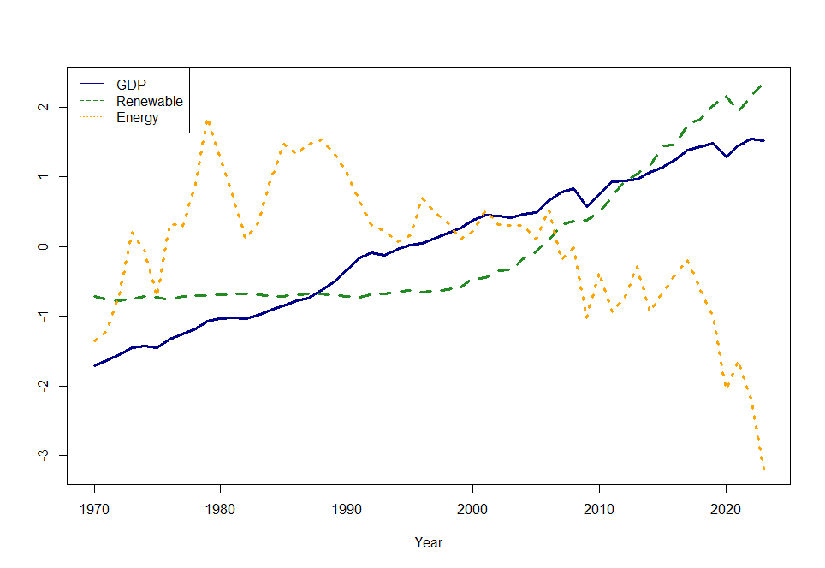
Multivariate Time Series Analysis - Motivation
Energy consumption has an impact on economic growth:
growth hypothesis: energy contributes to the growth process → unidirectional causality [1]
conservation hypothesis: economic growth causes consumption of energy. → unidirectional causality [1]
feedback hypothesis: energy contributes to growth which causes consumption of energy → bi-directional causality [1]
Since the last years energy consumption in Germany declined while GDP and renewable energy consumptions continued to grow.
Studies show an effect of renewable energy consumption on economic growth [2, 3, 4, 5]*.
Same time: economic growth effects CO2 emissions [6, 7, 8]
Is there a link between renewable energy consumption and Greenhouse gas emissions?
→ I build a Multivariate Time Series starting with a VAR to find out
Normalized values of GDP, Renewable energy consumption, Total energy consumption in Germany
* For [4] only very small effects and other paper seem to not find any.
Source: [1] Bhattacharya, Mita, et al. "The effect of renewable energy consumption on economic growth: Evidence from top 38 countries." Applied energy 162 (2016): 733-741.; [2] Bhattacharya, Mita, et al. "The effect of renewable energy consumption on economic growth: Evidence from top 38 countries." Applied energy 162 (2016): 733-741.; [3] Apergis, Nicholas, and James E. Payne. "Renewable energy consumption and economic growth: evidence from a panel of OECD countries." Energy policy 38.1 (2010): 656-660.; [4] Ivanovski, Kris, Abebe Hailemariam, and Russell Smyth. "The effect of renewable and non-renewable energy consumption on economic growth: Non-parametric evidence." Journal of Cleaner Production 286 (2021): 124956.; [5] Dogan, Eyup. "Analyzing the linkage between renewable and non-renewable energy consumption and economic growth by considering structural break in time-series data." Renewable energy 99 (2016): 1126-1136.
[6] Lu, Wen-Cheng. "Greenhouse gas emissions, energy consumption and economic growth: A panel cointegration analysis for 16 Asian countries." International journal of environmental research and public health 14.11 (2017): 1436.; [7] Yusuf, Abdulmalik M., Attahir Babaji Abubakar, and Suleiman O. Mamman. "Relationship between greenhouse gas emission, energy consumption, and economic growth: evidence from some selected oil-producing African countries." Environmental science and pollution research 27.13 (2020): 15815-15823.; [8] Hamit-Haggar, Mahamat. "Greenhouse gas emissions, energy consumption and economic growth: A panel cointegration analysis from Canadian industrial sector perspective." Energy Economics 34.1 (2012): 358-364.

Slide 7
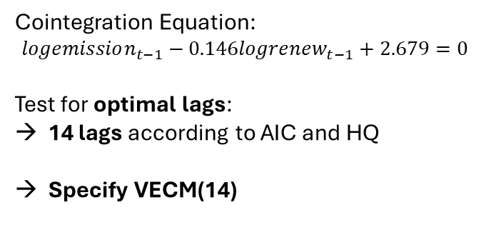
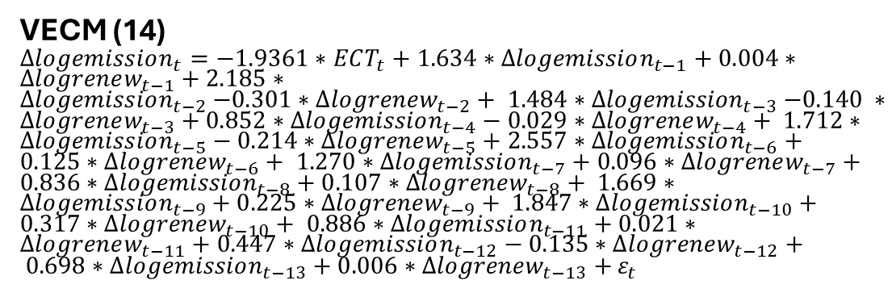
Building a Multivariate Modell
VAR(1) tried first
→ not valid
Check if cointegration exists
VECM (14)
$∆logemission_{t}=−1.9361∗ECT_{t}+1.634∗∆logemission_{t−1}+0.004∗∆logrenew_{t−1}+2.185∗∆logemission_{t−2}{−0.301∗∆logrenew_{t−2}+ 1.484∗∆logemission}_{t−3}−0.140 ∗∆logrenew_{t−3}+0.852∗∆logemission_{t−4}−0.029∗∆logrenew_{t−4}+ 1.712∗∆logemission_{t−5}−0.214∗∆logrenew_{t−5}+2.557∗∆logemission_{t−6}+0.125∗∆logrenew_{t−6}+ 1.270∗∆logemission_{t−7}+0.096∗∆logrenew_{t−7}+0.836∗∆logemission_{t−8}+0.107∗∆logrenew_{t−8}+ 1.669∗∆logemission_{t−9}+0.225∗∆logrenew_{t−9}+ 1.847∗∆logemission_{t−10}+0.317∗∆logrenew_{t−10}+ 0.886∗∆logemission_{t−11}+0.021∗∆logrenew_{t−11}+0.447∗∆logemission_{t−12}−0.135∗∆logrenew_{t−12}+ 0.698∗∆logemission_{t−13}+0.006∗∆logrenew_{t−13}+$ $ε_{t}$
Johansen-procedure
 | Test | 5pct
r <= 1 | 5.08 | 9.24
r = 0 | 23.38 | 19.96
There is one cointegrating relation !
Significant Variables
Variable |  | Estimate |  | P-value
ect1 |  | -1.936 |  | 0.111
Log(Renewable).dl2 |  | -0.301 |  | 0.047
Log(Emission).dl6 |  | 2.557 |  | 0.032
Log(Emission).dl10 |  | 1.847 |  | 0.038
F-Statistic |  | 1.396 |  | 0.277
Adjusted R-squared | 0.215 |  | R-squared |  | 0.759
Cointegration Equation:
$$logemission_{t−1}−0.146logrenew_{t−1}+2.679=0$$
Test for optimal lags:
14 lags according to AIC and HQ
Specify VECM(14)

Slide 8
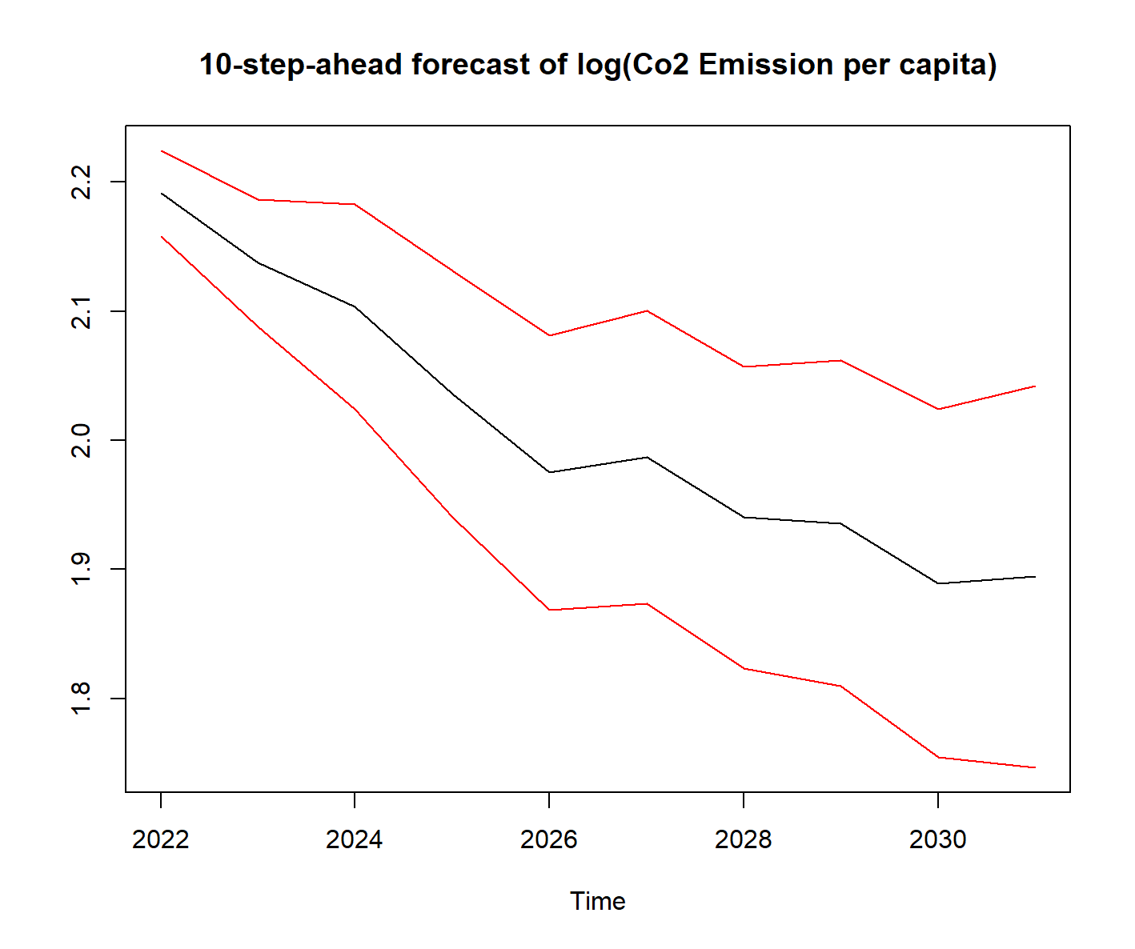
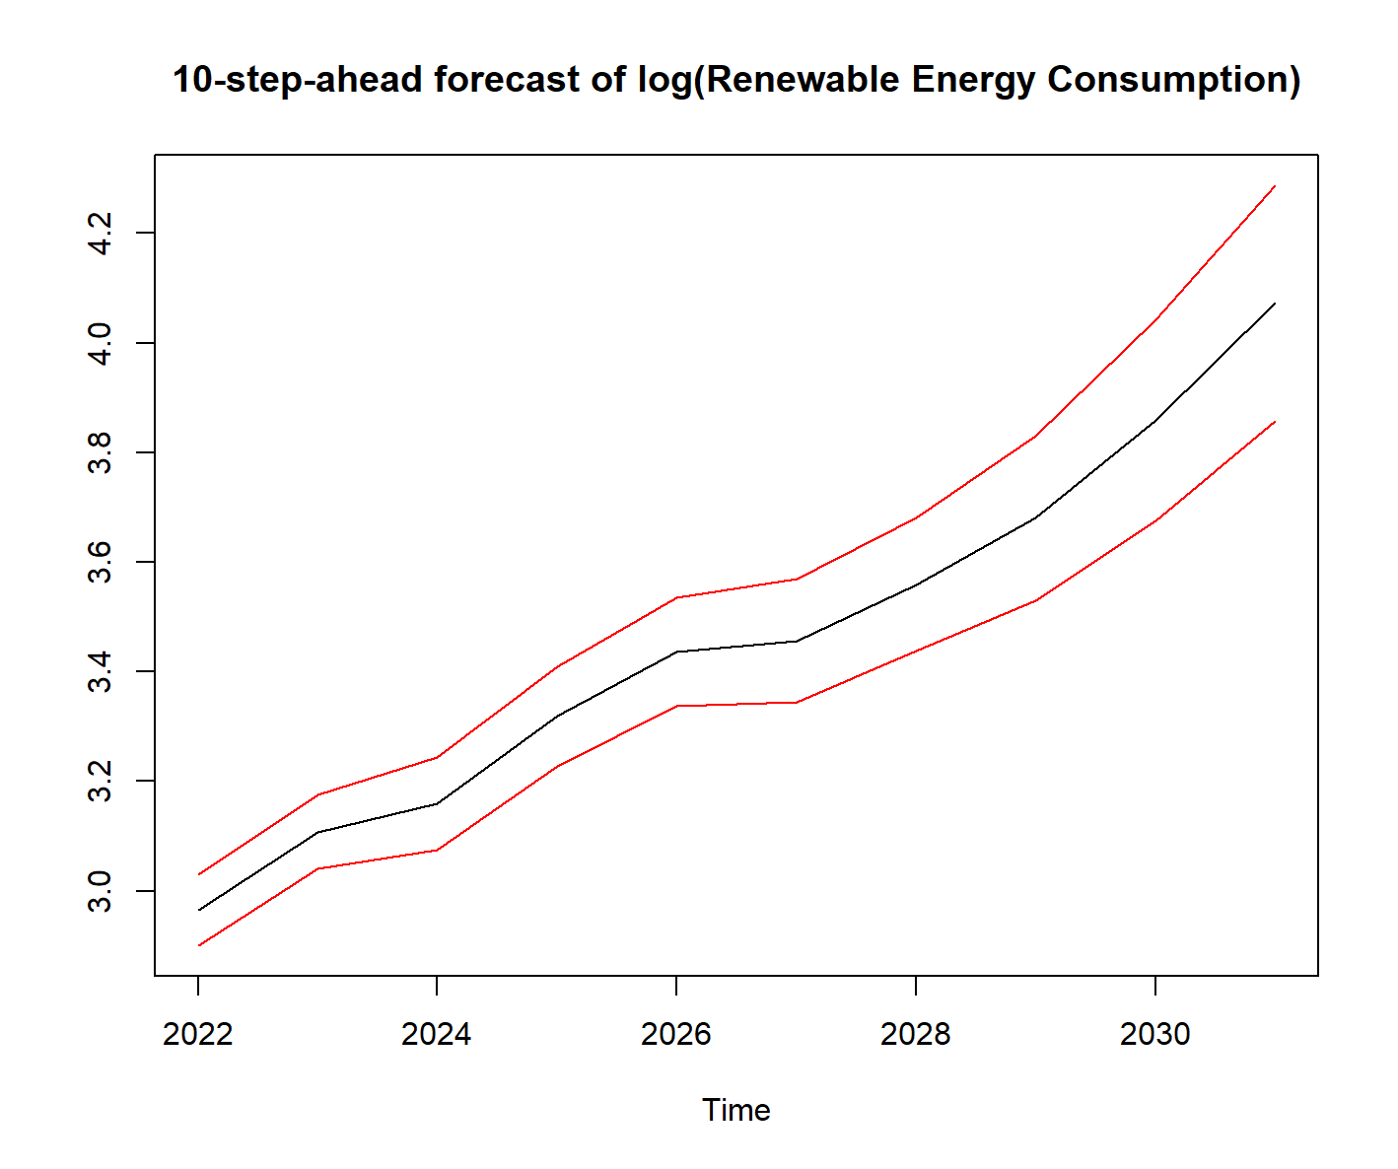
Interpretation and Forecast
Results show:
Short-term effect:
Negative effect of renewable energy consumption on emission → More consumption of renewable energy less CO2 emission per capita.
Positive effect of lagged emissions on todays emission → If emission have increased in the past, they will be higher today
Long-term effect:
Return fast to the average, but not significant
F-statistic none significant → Whole model is not significantly different from a model with just a constant
Adjusted R² much smaller than R² → Model might overfit the data
The 10-step-ahead forecasts of the VECM models show:
Downwards trend for CO2 emissions
Upwards trend for renewable energy consumption
To check the robustness of the findings: Add control variable economic growth and compare findings to findings in other countries* → Results see next slide
*Other countries selected due to different economic and spatial dimensions and data availability.

Slide 9
Robustness of the findings
Adding GDP per capita:
Captures economic growth → More robust coefficients and alleviate omitted variable bias
VECM(10)
Analyse the effect for different countries of different wealth:
Country | Income | Renew | Emission | Long-Term | Adj. R² | F-statistic
South Korea | High | Negative | Negative | -0.112 | 0.613 | 0.017
Belgium | High | insignificant | Negative | -0.185 | 0.231 | 0.001
USA | High | Negative | Positive | 0.562 insignificant | 0.359 | 0.140
China | Upper-Middle | insignificant | Positive | 0.031 | 0.504 | 0.000
Colombia | Upper-Middle | Negative, positive for higher lags | Positive | -1.36686 | 0.564 | 0.029
South Africa | Upper-Middle | Positive | Negative | 0.880 | 0.330 | 0.165
Egypt | Lower-Middle | Positive | Positive, negative for higher lags | 0.377 insignificant | 0.512 | 0.048
Sri Lanka | Lower-Middle | insignificant | insignificant | -0.024 insignificant | -0.208 | 0.742
Morocco | Lower-Middle | Positive, negative for higher lags | negative | 0.027 insignificant | 0.509 | 0.049
Due to space limitation only Significant Variables
Variable | Estimate |  | P-value
ect1 | -0.711 |  | 0.009
ect2 | -0.042 |  | 0.038
Log(Emission).dl1 | 1.073 |  | 0.001
Log(GDP).dl1 | -1.051 |  | 0.001
Log(Emission).dl2 | 1.164 |  | 0.005
Log(Emission).dl6 | 1.027 |  | 0.002
Log(Renewable).dl6 | 0.236 |  | 0.001
Log(GDP).dl6 | -1.065 |  | 0.020
F-Statistic | 4.332 |  | 0.003
Adjusted R-squared | 0.692 | R-squared |  | 0.899
Still positive effects of lagged emission
Surprisingly, negative effects of GDP on emission, and significant positive effect of renewable energy consumption
Increased Adjusted R-squared
Significant F-statistic
*income level classification taken from World Bank: https://datatopics.worldbank.org/world-development-indicators/the-world-by-income-and-region.html

Slide 10
Conclusion
Univariate Analysis
Renewable energy consumption is best modelled with an ARMA (1,1,1) model
Renewable energy consumption is likely to increase in the next years
Multivariate Analysis
I find a negative short-term link between renewable energy consumption and CO2 emission
By adding GDP per capita I find negative effects of economic growth on CO2 emission but positive effects of renewable energy consumption.
Renewable energy consumption might have captured the effect of economic growth
Comparing findings to 9 countries of different economic power:
Poorer countries seem to show positive effects of renewable energy consumption, compared to negative effects in richer countries.
Some Models show positive long-term effects which could indicate that they are wrongly specified.
Possible explanation:
Economic growth through more efficient technologies in richer countries → Renewable energy replaces fossil fuels → less energy needed despite economic growth + used energy emits less CO2
More energy leads to more industry → Renewable energy does not replace other sources → more emissions
Possible Improvements of the study:
Use more countries with longer time series and estimate panel VECM for better inference
Adding more control variables
Renewable energy influences CO2 emission however, the direction depends on the economic size of the country.
Further research must be done to give further robustness to the finding.

